Slide 1
The Worst Presentation Ever
What not to do with your slides
(Please view as slideshow)

Slide 2
Rule number one:
SAY it, don’t read it:
Not so good on a slide….
Better
Keep it simple: Design. Flow. Outline. Less is more.
What is the take home? The general rule is that no more than three points should be emphasized.
Tell a story if you can. This provides context and is more likely to be remembered.
Keep it professional. Don’t use a bunch of stickers, sports allegories, cartoons, personal information, etc. etc. etc.
Cite sources/references, thank collaborators, and provide your contact information.
Keep it simple
Three points
Story = Context
Be professional
Acknowledge others

Slide 3
Not so good on a slide….
Keep it simple: Design. Flow. Outline. Less is more.
What is the take home? The general rule is that no more than three points should be emphasized.
Tell a story if you can. This provides context and is more likely to be remembered.
Keep it professional. Don’t use a bunch of stickers, sports allegories, cartoons, personal information, etc. etc. etc.
Cite sources/references, thank collaborators, and provide your contact information.
Everyone is reading – few are listening!

Slide 4
Better…
Keep it simple
Three points
Story = Context
Be professional
Acknowledge others

Slide 5
DO NOT USE A DISTRACTING BACKGROUND
Simple is better
KEEP
THE
ANIMATIONS
TO
A
MINIMUM
And, while you’re at it, don’t use an obscure, unprofessional, or distracting font
Do everyofne a favore and proof your kontent!

Slide 6
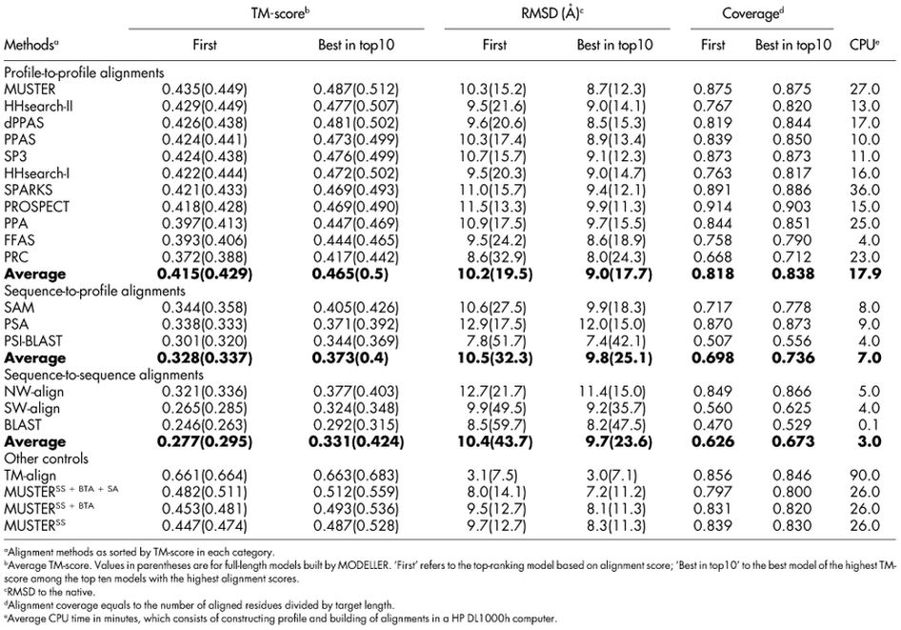
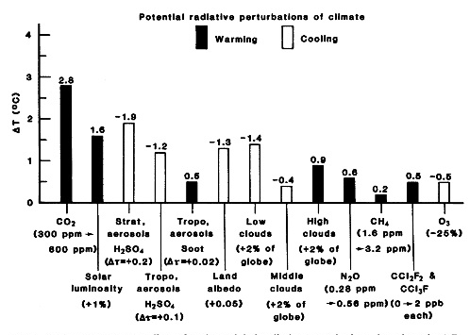
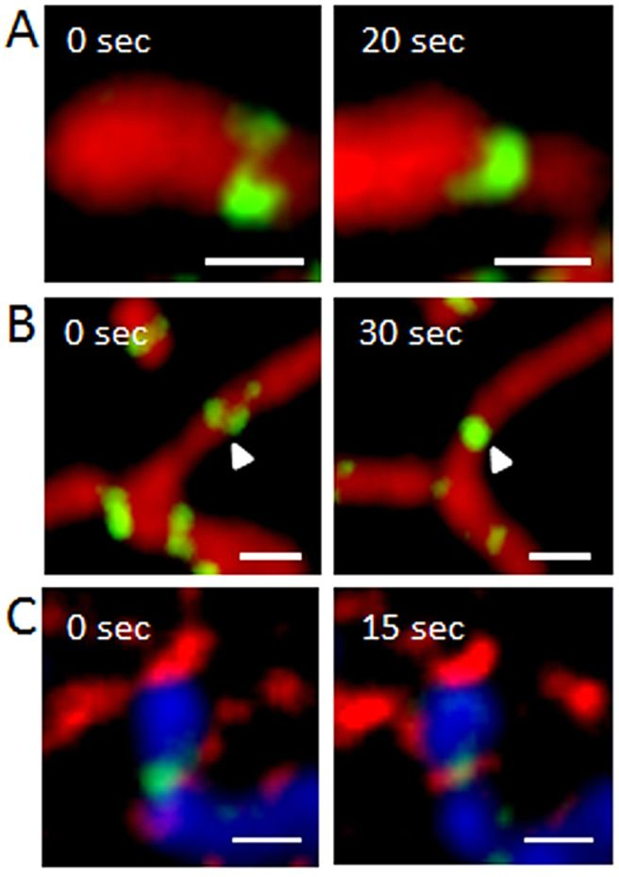
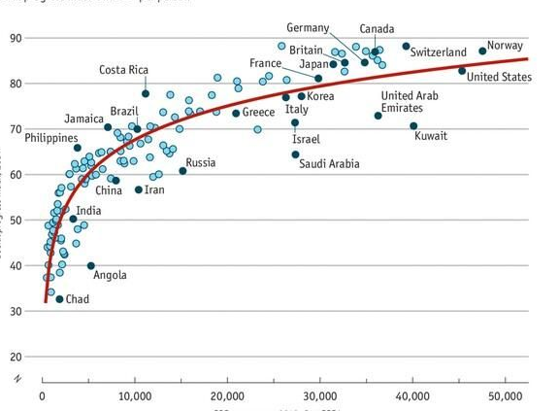
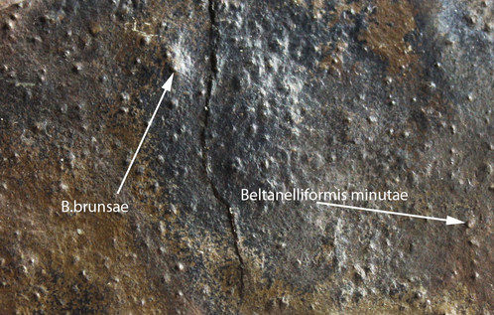
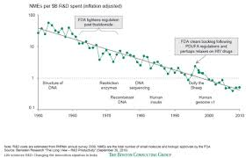
Experiments I did last summer:
Um, No. Too much, too small. More than one point, theme, or graphic per slide generally does not work.

Slide 7

Effective communication is DA BOMB!!!!!!!!!
This is wrong on so many levels. The use of slang is unprofessional, exclamation points are out of place in a serious presentation, the font is distracting/difficult to read, and all-caps makes your audience feel yelled at. The background is also a headache waiting to happen.

Slide 8
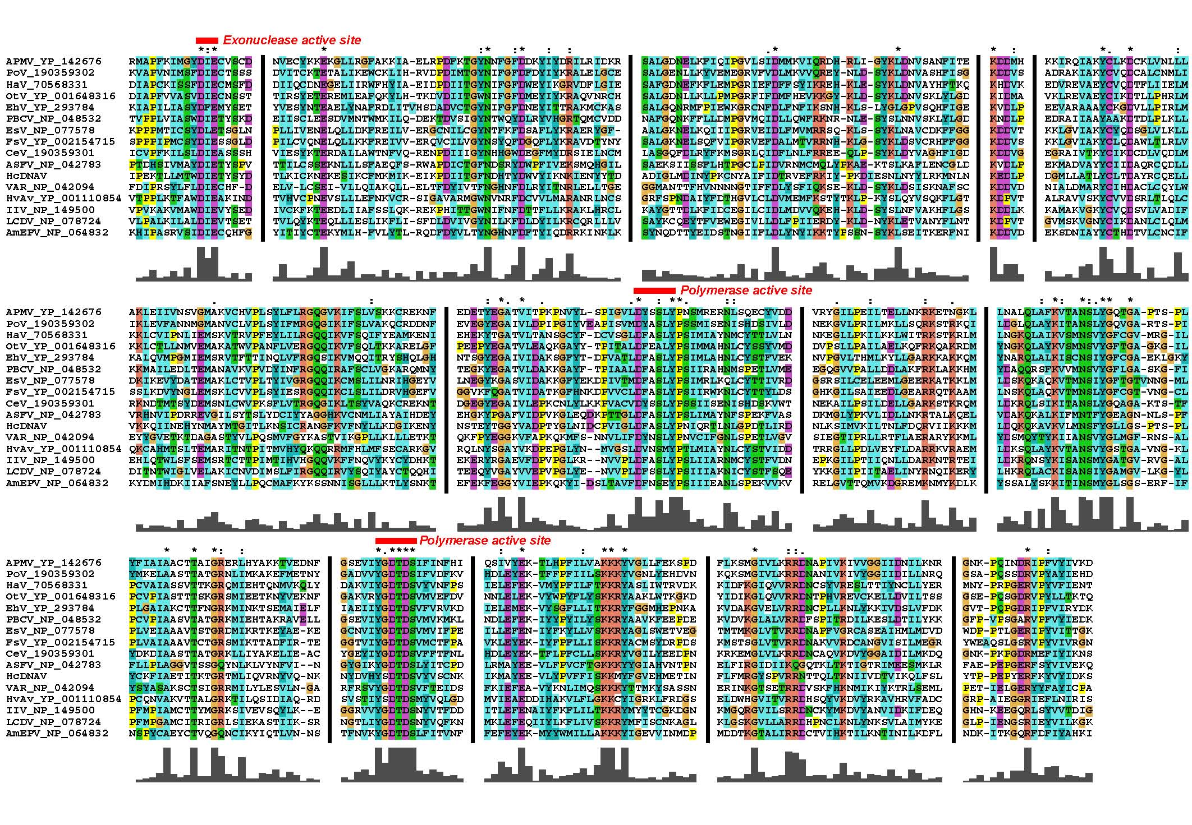
Nobody can read this – including you.

Slide 9
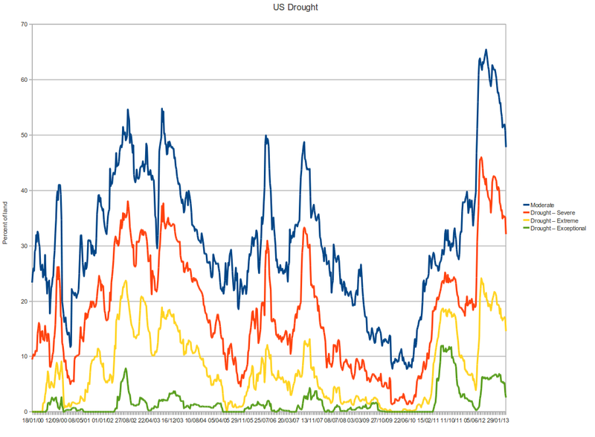
Nice visual, but it would be difficult to see the x and y axis and legend from more than a few rows back

Slide 10
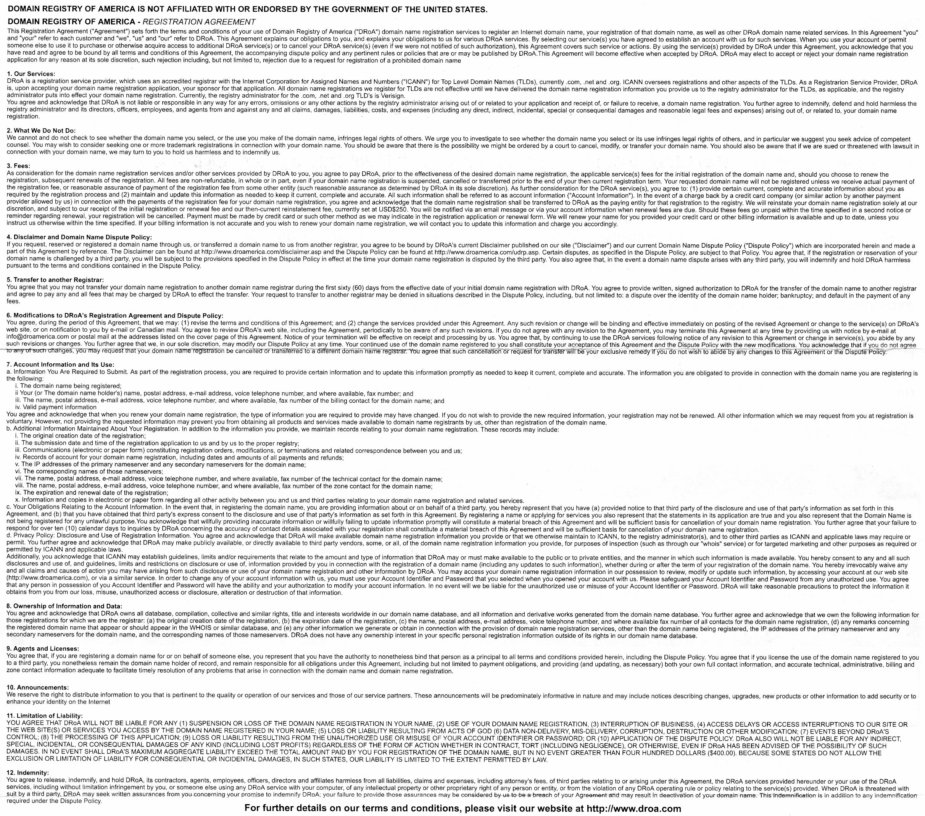
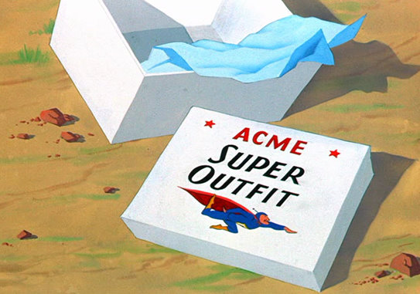
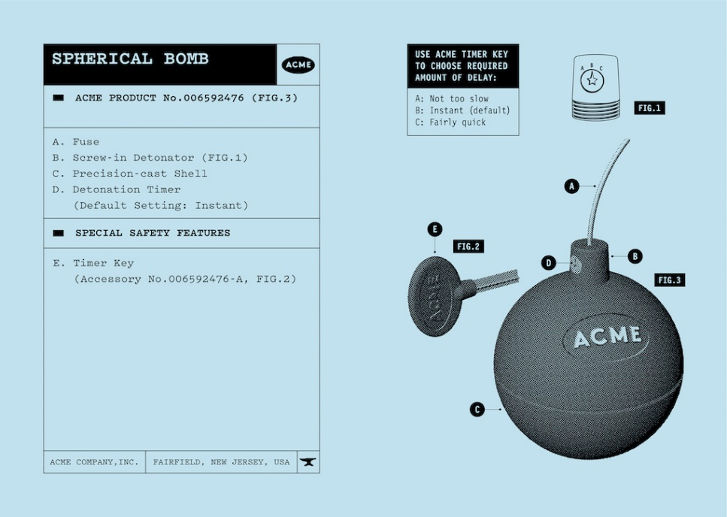
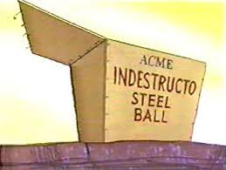
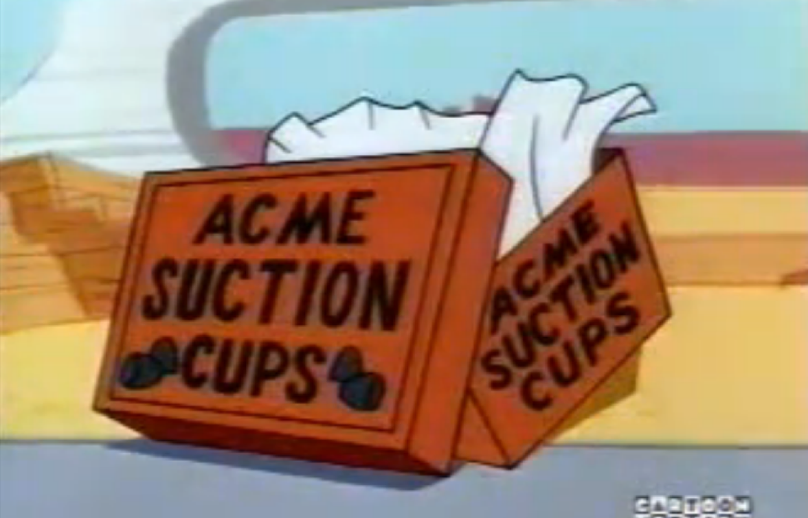
The Protocol (what’s wrong with these pictures?):
Do not use company images or logos on any of your slides.
Really.
Also: Avoid (or acknowledge) Trademarks

Slide 11

Be sure to lock your aspect ratio*.
*If you don’t know what this is, ask!

Slide 12
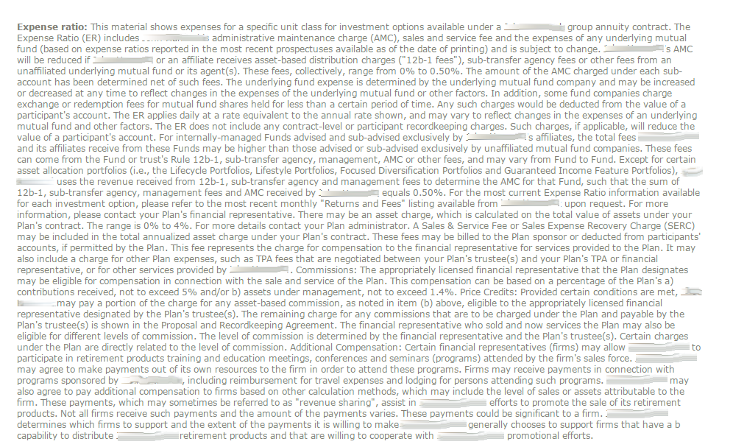
If you have to apologize for your slide, it doesn’t belong in your presentation.

Slide 13
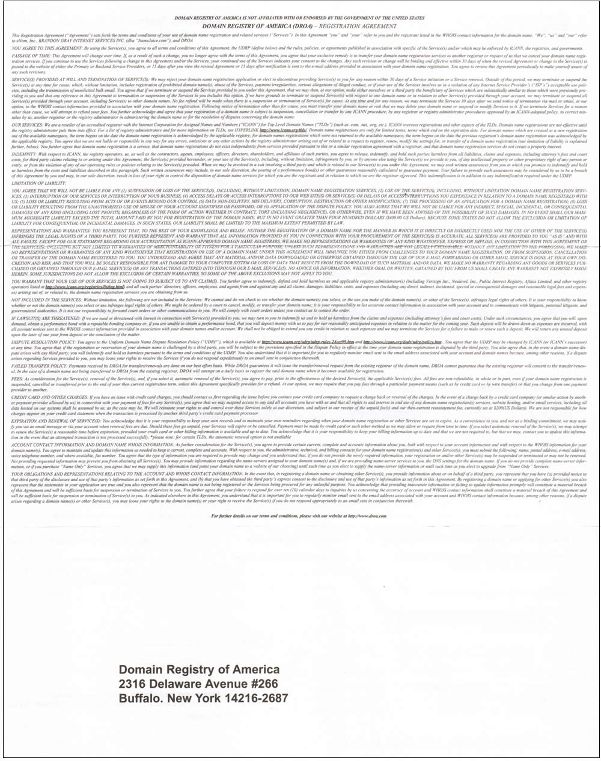
An arrow doesn’t help.
Really.
Neither does highlighting
Both? Uh, no.

Slide 14
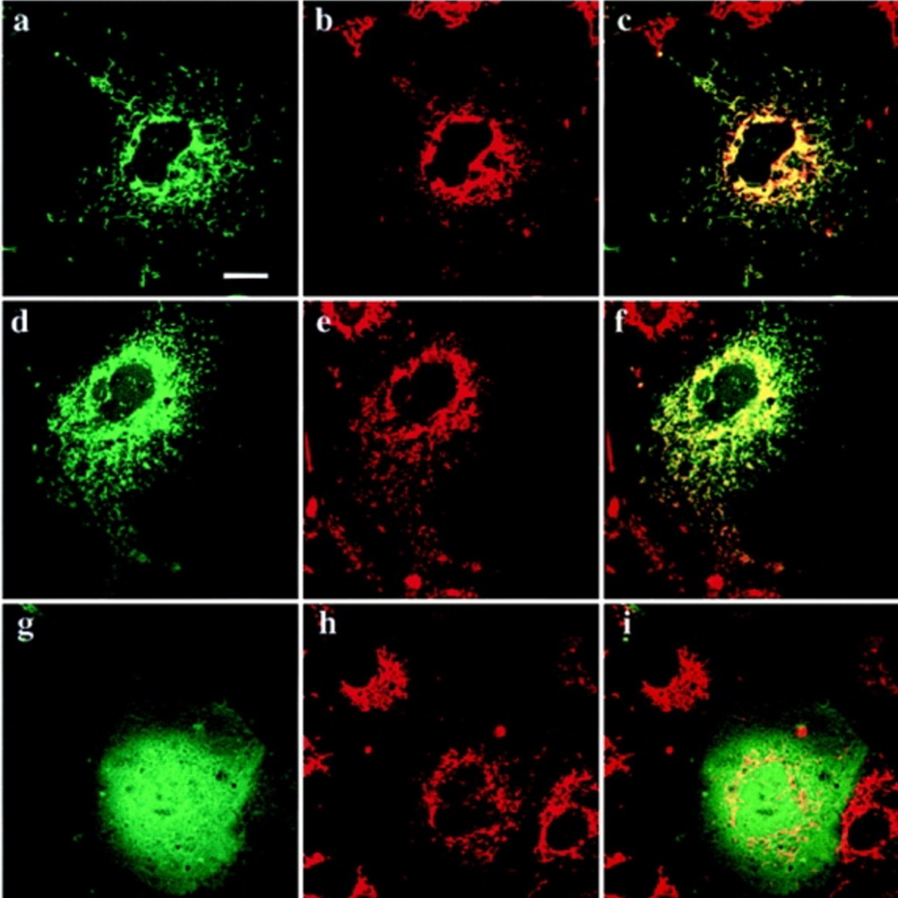
If

Slide 15
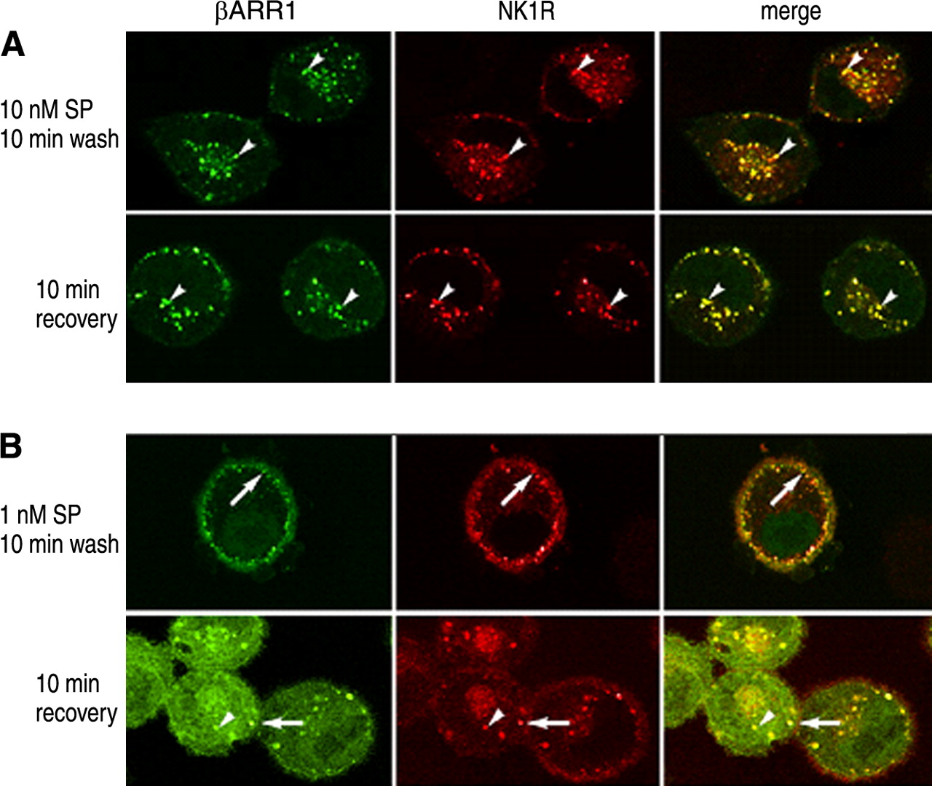
you

Slide 16
have

Slide 17
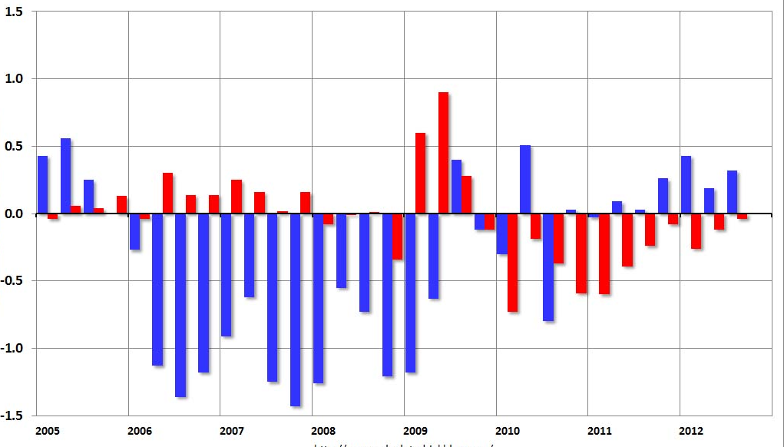
more

Slide 18
than

Slide 19
one

Slide 20
slide

Slide 21
per

Slide 22
minute

Slide 23
of

Slide 24
time,

Slide 25
you

Slide 26
will

Slide 27
likely

Slide 28
go

Slide 29
on

Slide 30
way

Slide 31
way

Slide 32
way

Slide 33
too

Slide 34
long….

Slide 35

Thank you for your participation at an AMP Educational Event.

